Slide 1
RECURSION
TUAN NGUYEN

Slide 2
OUTLINE
Factorial
Binary Search
Fibonacci number
Max depth recursion
Tail recursion

Slide 3
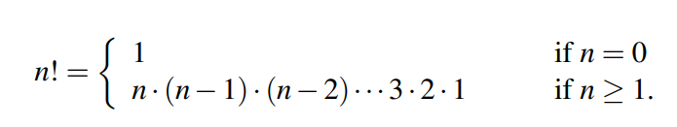
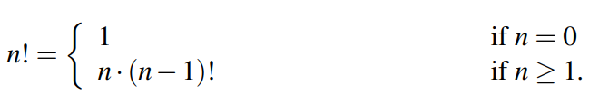
The Factorial Function
The factorial of a positive integer n, denoted n!, is defined as the product of the integers from 1 to n
We observe that n! = n * (n-1)!. Then recursive definition can be formalized as:
Base case
Recursive case

Slide 4
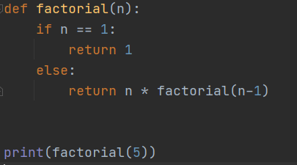
The Factorial Function (1)
Compute big-O of this algorithm

Slide 5
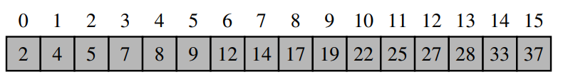
Binary Search
Given sorted array, find a number in the array, return True if the number is found, False otherwise.
def (arr, number):
#TODO
return…

Slide 6
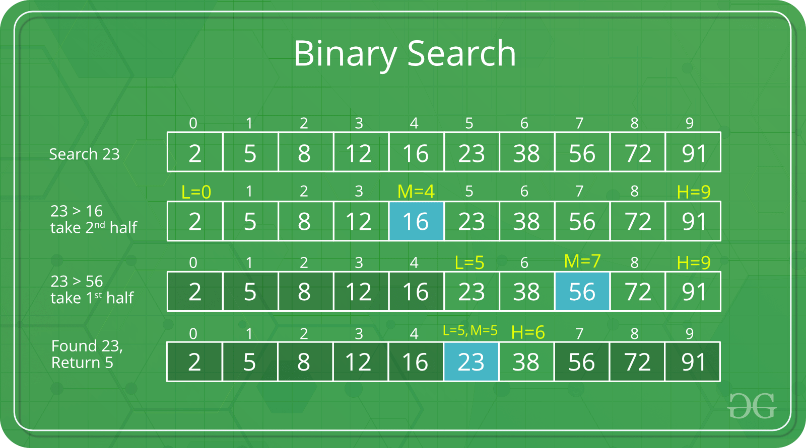
Binary Search (1)

Slide 7
Binary Search (2)

Slide 8
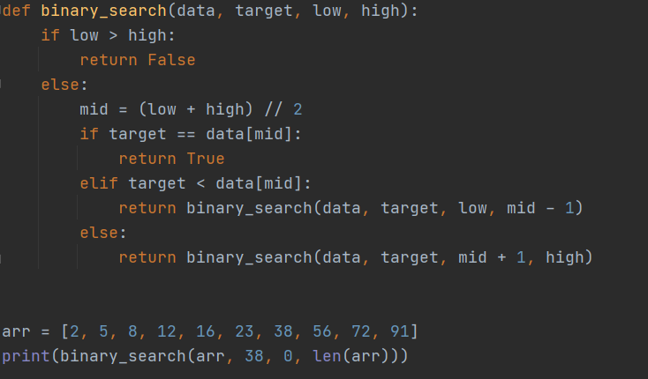
Binary Search (3)
Compute big-O of this algorithm

Slide 9
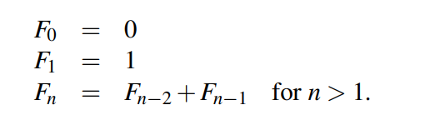
Fibonacci Numbers
Fibonacci numbers: 0, 1, 1, 2, 3, 5, 8, 13, 21,…..
Write recursive Python code to calculate Fibonacci numbers.

Slide 10
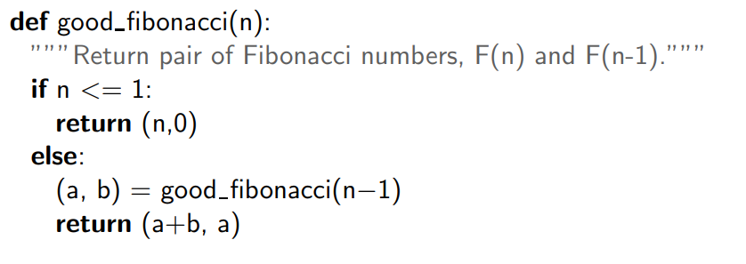
Efficient Recursion

Slide 11

Maximum Recursive Depth
Infinite recursion
The precise value of this limit depends upon the Python distribution, but a typical default value is 1000. If this limit is reached, the Python interpreter raises a RuntimeError with a message, maximum recursion depth exceeded

Slide 12
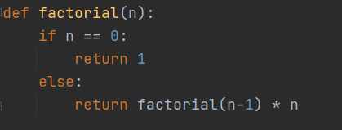
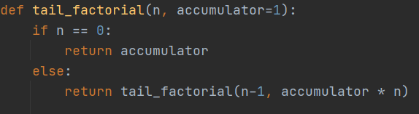
Tail Recursion
Tail recursion is optimized
However, Python does NOT optimize tail recursion
Should avoid recursion if possible.

Slide 13
Exercise
Write a recursive function to reverse string.
Input: “hello world” -> output: “dlrow olleh”

